Slide 1

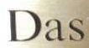



Albert Gordo
Lluís Gómez
1

Slide 2
Agenda
Introduction [10:00 – 10:10]
Scene-text Localization [10:10 – 10:55]
Theoretical introduction
Practical
Scene-text Recognition [10:55 – 11:40]
Theoretical introduction
Practical
Coffe break [11:40 – 12:00]
Scene-text Understanding [12:00 – 12:40]
Theoretical introduction
Practical
Closing Remarks [ 12:40 – 12:50]
Discussion [ 12:50 – 13:00]
2

Slide 3
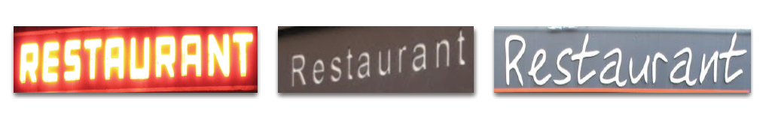

Recognition
Recognition: transcription of cropped word images
“Recognition”
Other related tasks include query-by-text / word spotting:
“Restaurant”
Also image matching:
3

Slide 4
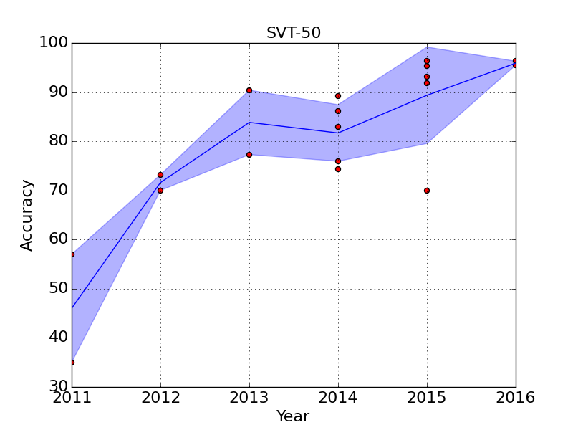
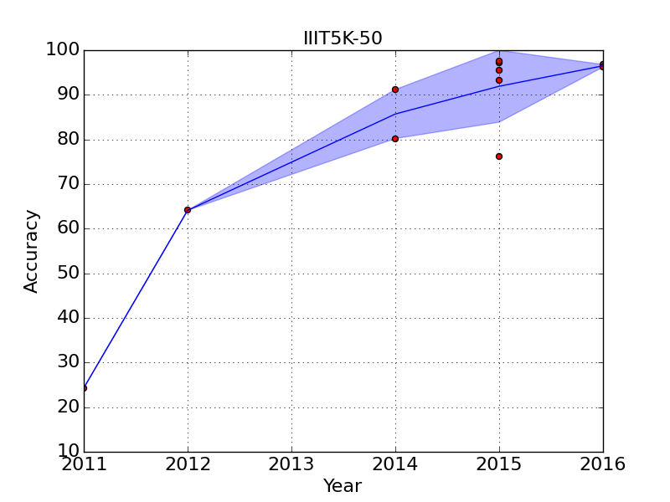
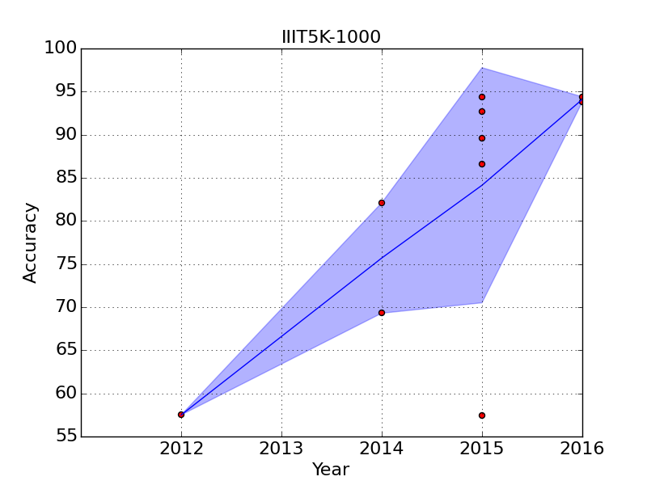
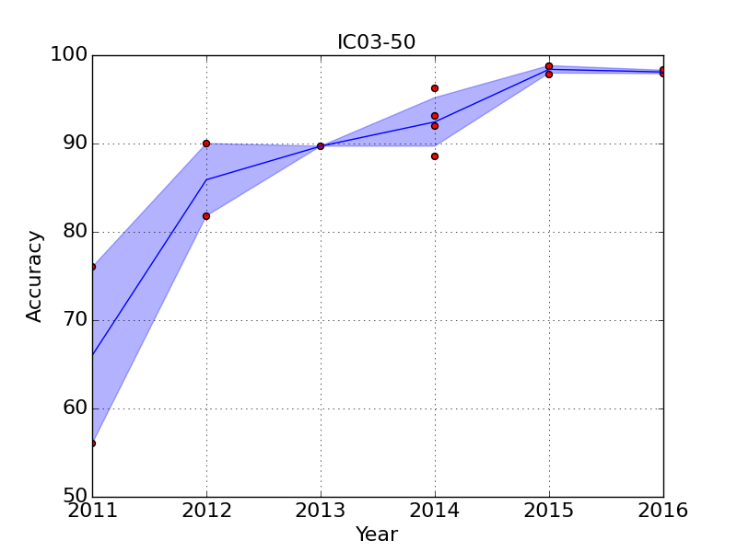
Evolution of the state of the art
4

Slide 5
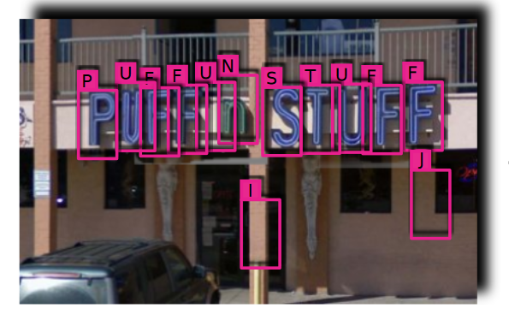
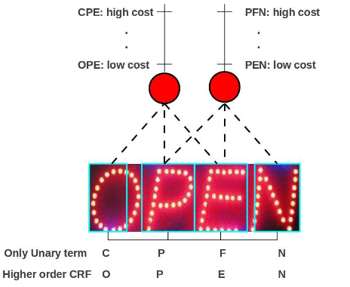


Two Main Approaches for Recognition
1. Explicitly localize and recognize the characters:
[Wang’10, Wang’11, Mishra’12a, Mishra’12b, Bissacco’13]
Localizing the characters is error prone and slow at test time
Character recognition is done independently or with little context
Tailored for recognition
State-of-the-art results in 2013 by Google’s PhotoOCR
Currently out of favour
5

Slide 6
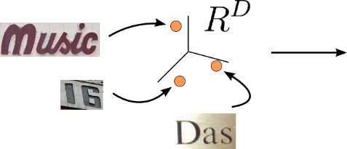


Two Main Approaches for Recognition
2. Global representation of the word image (no character detection)
Early methods use two-step process: first encode and then learn an end task.
Recognition
Word Matching
Word Spotting
Clustering
…
[Rodriguez’13, Almazan’13, Almazan’14, Rodriguez’15, Gordo’15a]
No character localization at test time
Multiple applications
Fixed length representation
Does not use character annotations at train time ([Gordo’15a] does )
Good accuracy
Two-step process
6

Slide 7
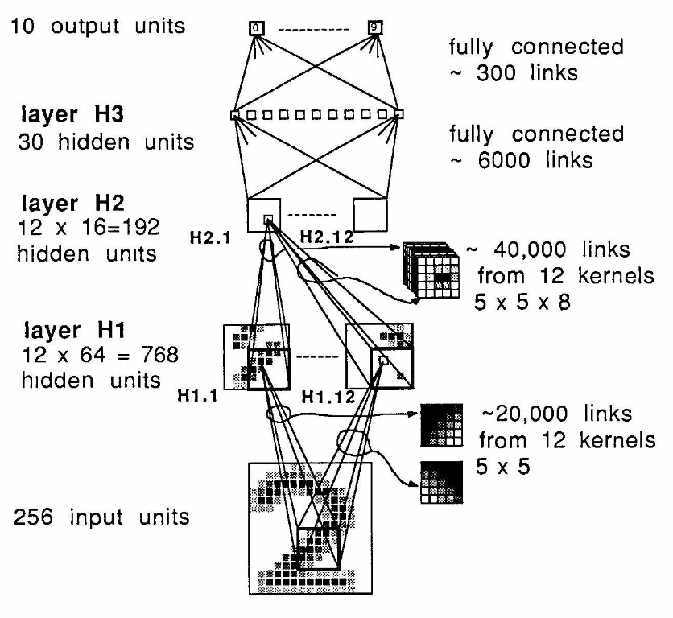
Convolutional Neural Networks 101
CNNs are locally-connected neural networks. [LeCun’89] is an early example.
Convolutional layers are combined with pooling (e.g. max pooling) and non-linearities (e.g. tahnh, ReLU).
Combines feature learning and end-task in a single process. All parameters are learned jointly in a supervised setting using backpropagation
Since 2012 they have disrupted the CV community [Krizhevsky’12]
[LeCun’89]
7

Slide 8
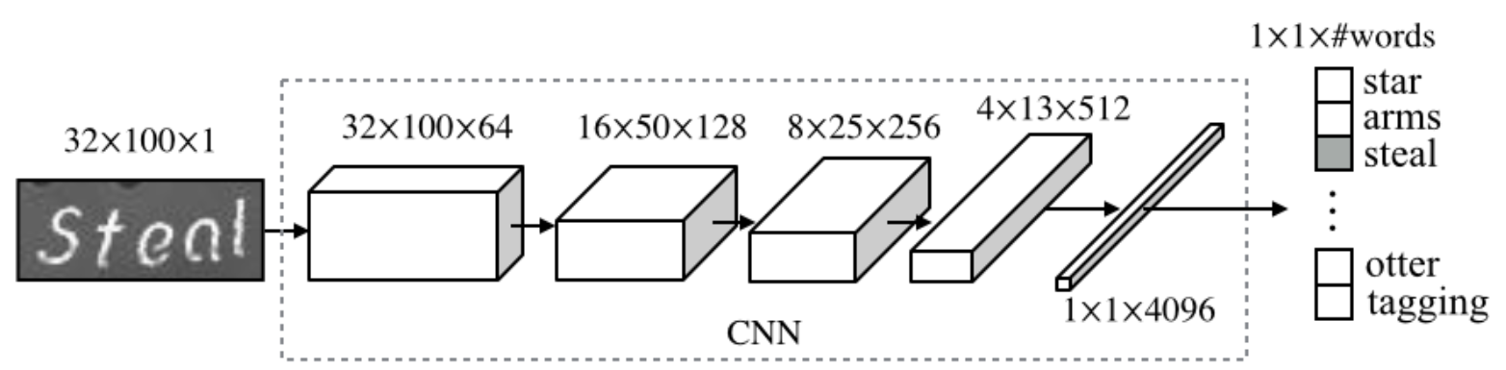
Two Main Approaches for Recognition
2. Global representation of the word image (no character detection)
New methods: end-to-end learning with CNNs
First idea: word image recognition as classification with a closed vocabulary
[Jaderberg’14b, Jaderberg’15a]
Significantly outperformed the state of the art
Intermediate layers can be used as a word representation
Closed Vocabulary
8

Slide 9
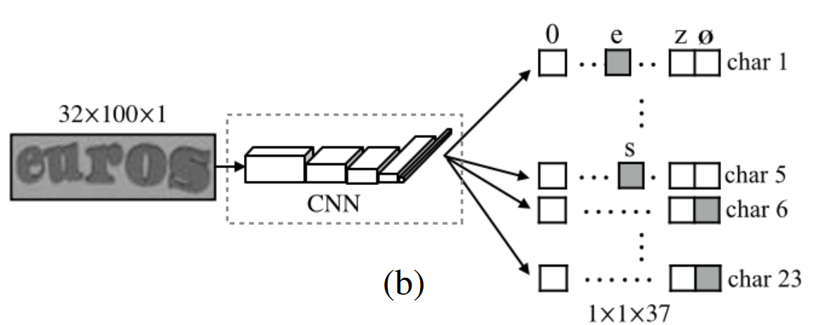
Two Main Approaches for Recognition
2. Global representation of the word image (no character detection)
New methods: end-to-end learning with CNNs
Second approach: word image recognition as character / position recognition
[Jaderberg’14b]
Open vocabulary (but can work with a lexicon if available)
Intermediate layers can be used as a word representation
Results almost-as-good as the dictionary version
Trainable in a few hours. See our Github for a model trained on IAM!
9

Slide 10
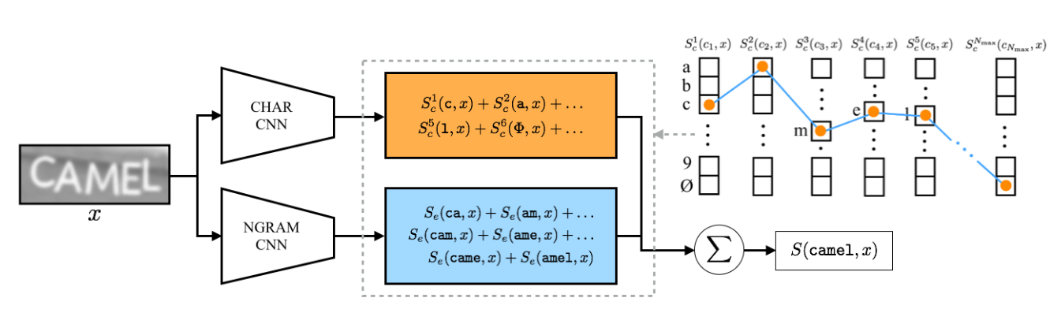
Improvements
Joint recognition of individual characters and ngrams [Jaderberg’15b]
Character CNN and ngram CNN learned jointly with an structured loss.
More sound that classifying only the individual characters
10

Slide 11
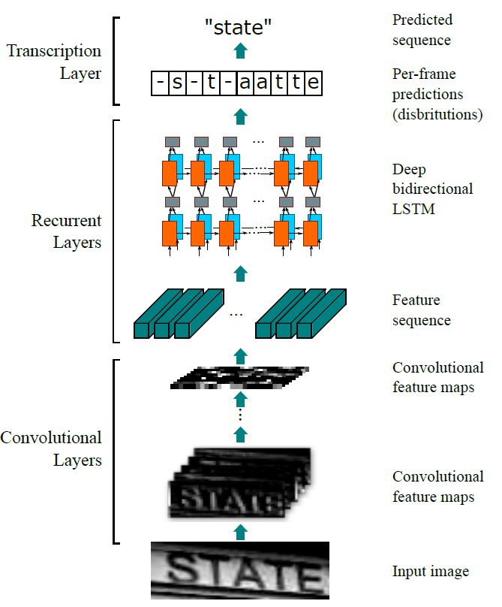
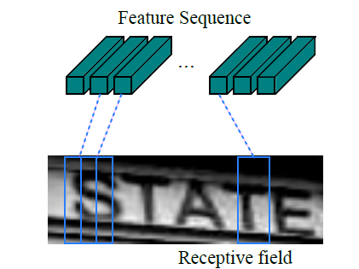
Improvements
Words as sequences
Sliding window over CNN features instead of considering the whole image jointly
Sequence learning with LSTMs [Hochreiter’97] and CTC [Graves’06]
More flexible, but also more complex
[Shi’15, He’15]
11

Slide 12
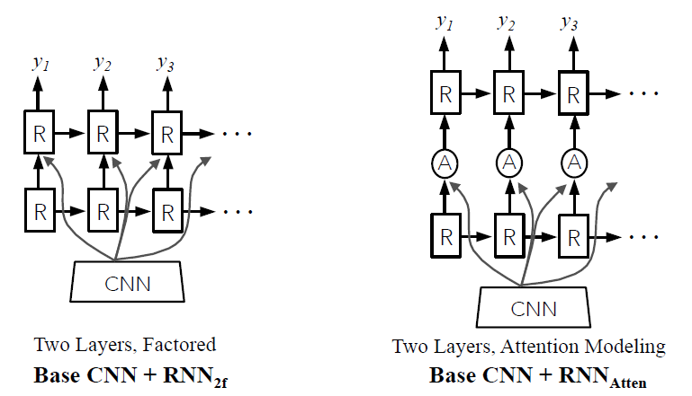
Improvements
Attention models
Not all regions in the word image are important
Learn to focus on the important parts using an attention mechanism
[Lee’16]
12

Slide 13
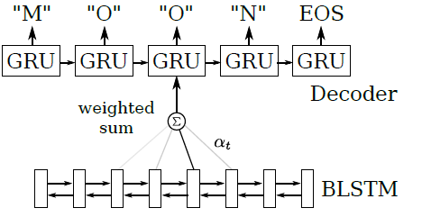
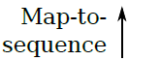
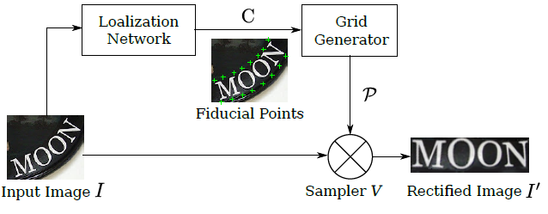
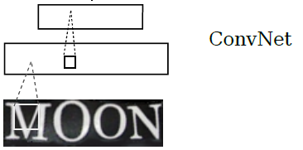
Improvements
Distortion correction
Distorted images make recognition difficult
Simultaneously learn to correct the image and to recognize the word
Similar to Spatial Transformer Networks [Jaderberg’15c]
[Shi’16]
13

Slide 14
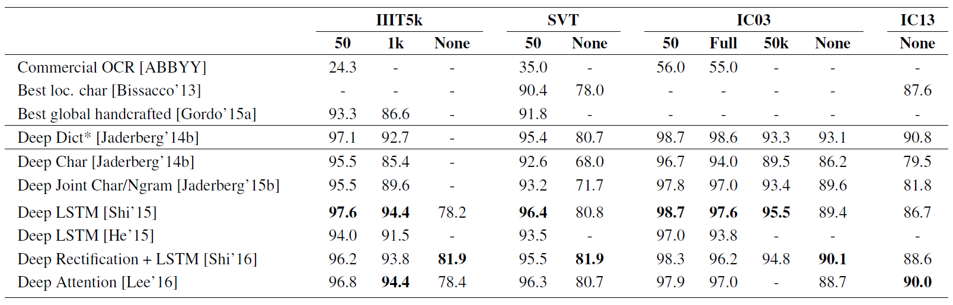
Results summary
Current state of the art
14

Slide 15
Conclusions
End-to-end learning with CNNs is a must to obtain state-of-the-art results
Character model yields very competitive results at an affordable cost (simple model, few hours of training)
Other improvements (sequences, attention models, etc) further improve the accuracy, but come at a cost
Standard benchmarks are almost solved. Need for more challenging datasets [Yao’15, Veit’16] and new tasks
15

